Slide 1

B.M.S. COLLEGE OF ENGINEERING
Department of Computer Science and Engineering

Slide 2
Project Presentation
On
COGNITIVE APPREHENSIVE DEVICE
Under the Guidance of : Mr. Lohith J.J. (Assistant Professor, BMSCE)
Mr. T V Prabhakar (Senior Scientist Officer, CEDT Dpt., IISc)
Submitted by:
RAKSHA DESAI
PRERNA BAJAJ
PRONOY DALAL
VARDAAN TYAGI

Slide 3
AGENDA
COGNITIVE APPREHENSIVE DEVICE
INTRODUCTION
MOTIVATION
LITERATURE SURVEY
DESIGN
IMPLEMENTATION ALGORITHM
SEQUENCE DIAGRAM
HARDWARE AND SOFTWARE USED
TESTING
CONCLUSION AND FUTURE ENHANCEMENTS

Slide 4
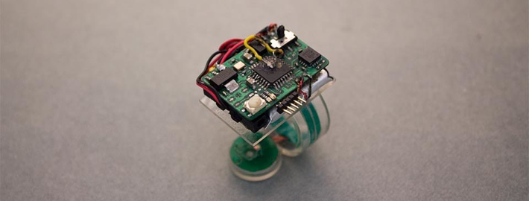
INTRODUCTION
COGNITIVE APPREHENSIVE DEVICE
What is COGNITIVE JEWELLERY?
Jewellery that incorporates sensors, actuators and wireless communication chips to enhance human experience.

Slide 5

INTRODUCTION
COGNITIVE APPREHENSIVE DEVICE
What DOES OUR DEVICE DO?
It is an innovative security device whose primary purpose is to provide safety especially to women when in danger by sensing any kind of attack on them.

Slide 6
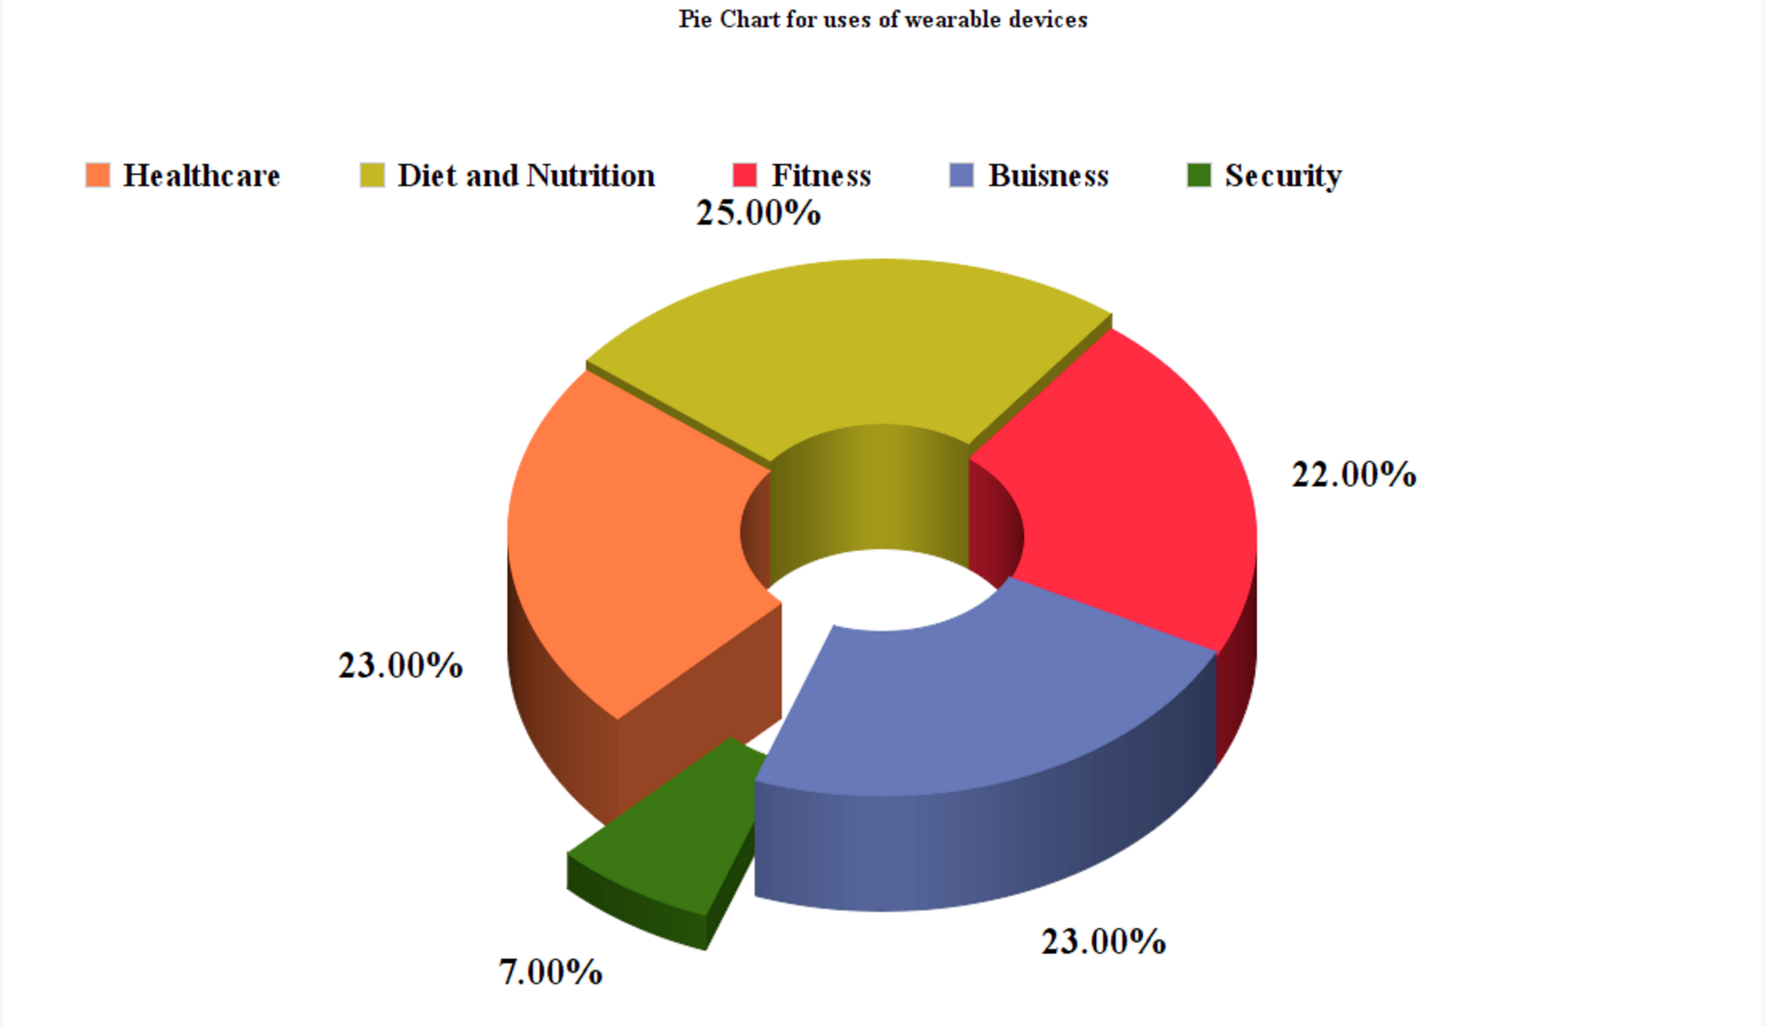
MOTIVATION
COGNITIVE APPREHENSIVE DEVICE
What motivated us?
Increase in assaults especially on women.
Using technology to secure human lives.
Lack of wearable devices that can be used for safety purposes.

Slide 7
LITERATURE SURVEY
COGNITIVE APPREHENSIVE DEVICE
BLE consumes less power as compared to the classic bluetooth.
BLE sends data in episodes and not as continuous chain of data.
BLE developed WSNs, result in reduced noise.
Integrates energy harvesting technologies.BLE provides multi-mode WSNs

Slide 8
LITERATURE SURVEY
COGNITIVE APPREHENSIVE DEVICE
Integration of phone based accelerometer.
Use of labelled data for more precision.
Use of GSM modules to determine location.
Use of Android Phone with a Tri-axial accelerometer, which evaluates with several threshold based algorithms and position data.
Integration of accelerometer and wearable based motion detectors.

Slide 9
LITERATURE SURVEY
COGNITIVE APPREHENSIVE DEVICE
Multimodal “eyes free” interaction technique for wearable devices.
Integration of wearable sensors in wearable devices.
31 pin Architecture of ATMEL AT 8052
Development tools such as Keil C166
Use of nRF dongle and Bluetooth smart stack protocols.
Use of Sousveillance

Slide 10
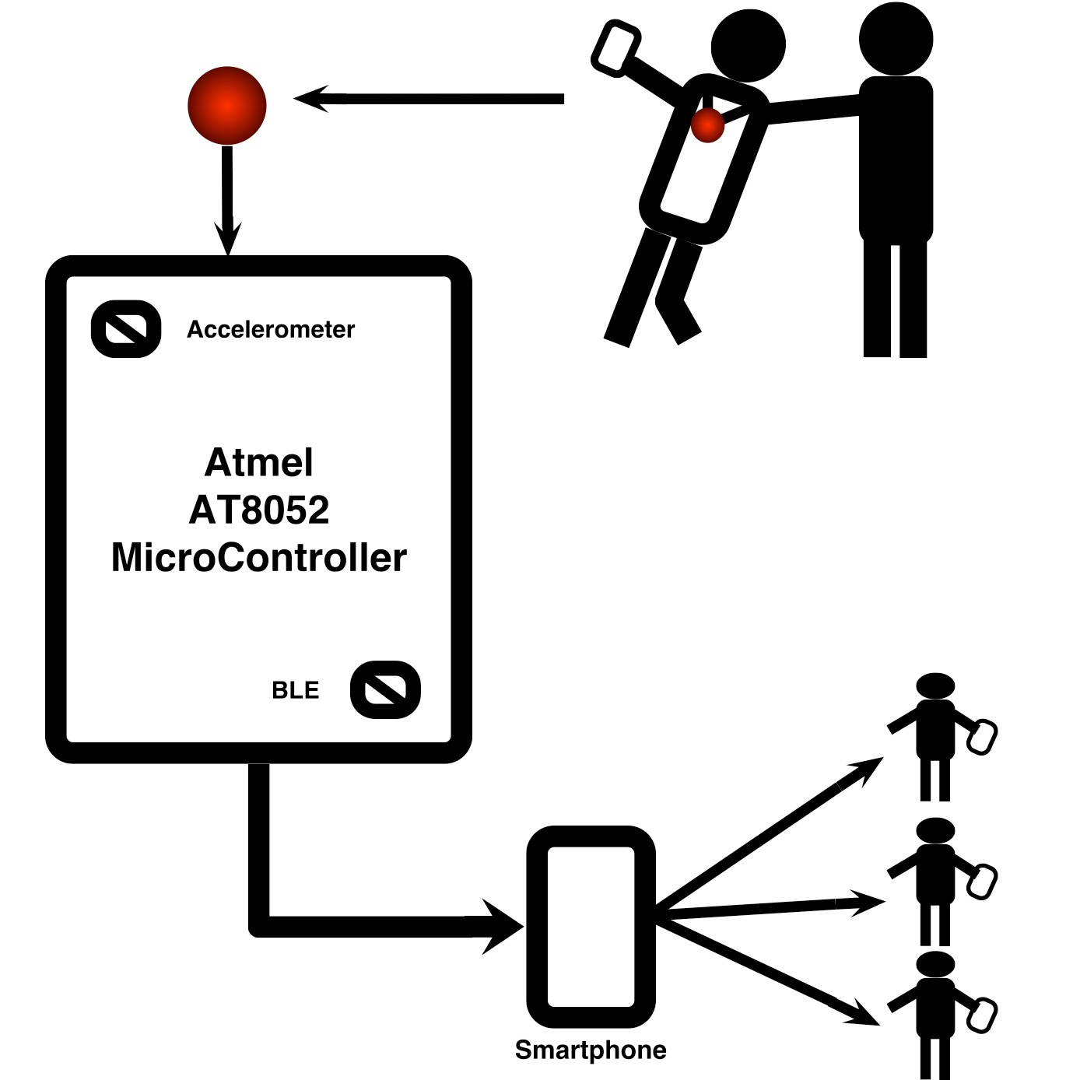
DESIGN
COGNITIVE APPREHENSIVE DEVICE

Slide 11
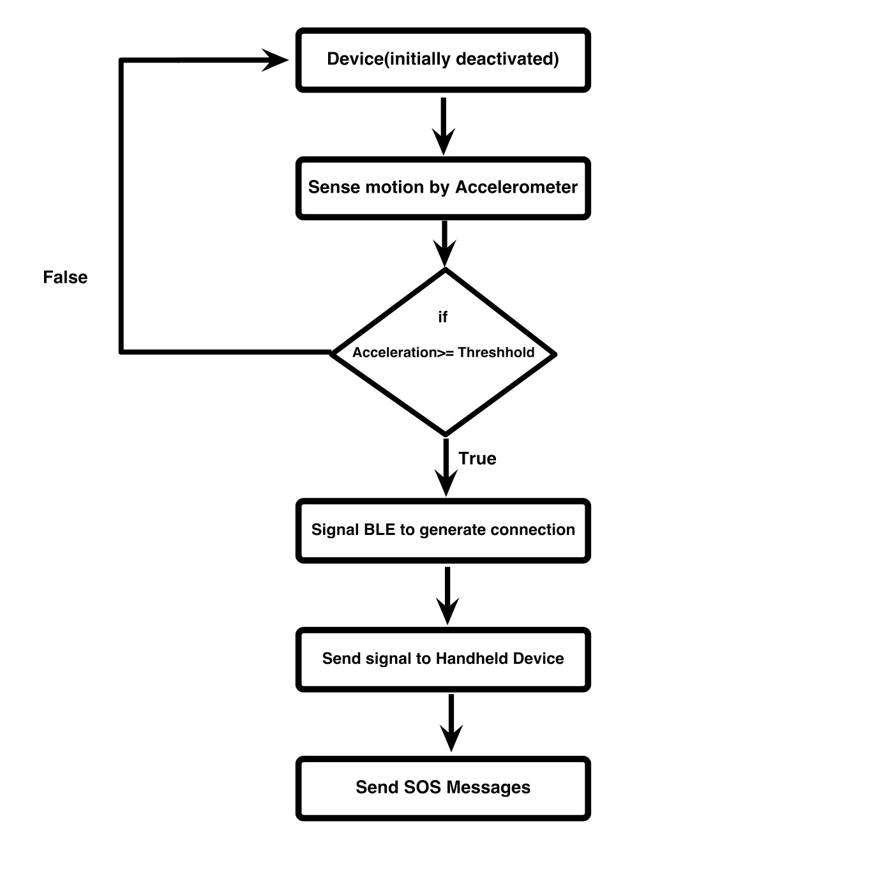
IMPLEMENTATION ALGORITHM
COGNITIVE APPREHENSIVE DEVICE

Slide 12
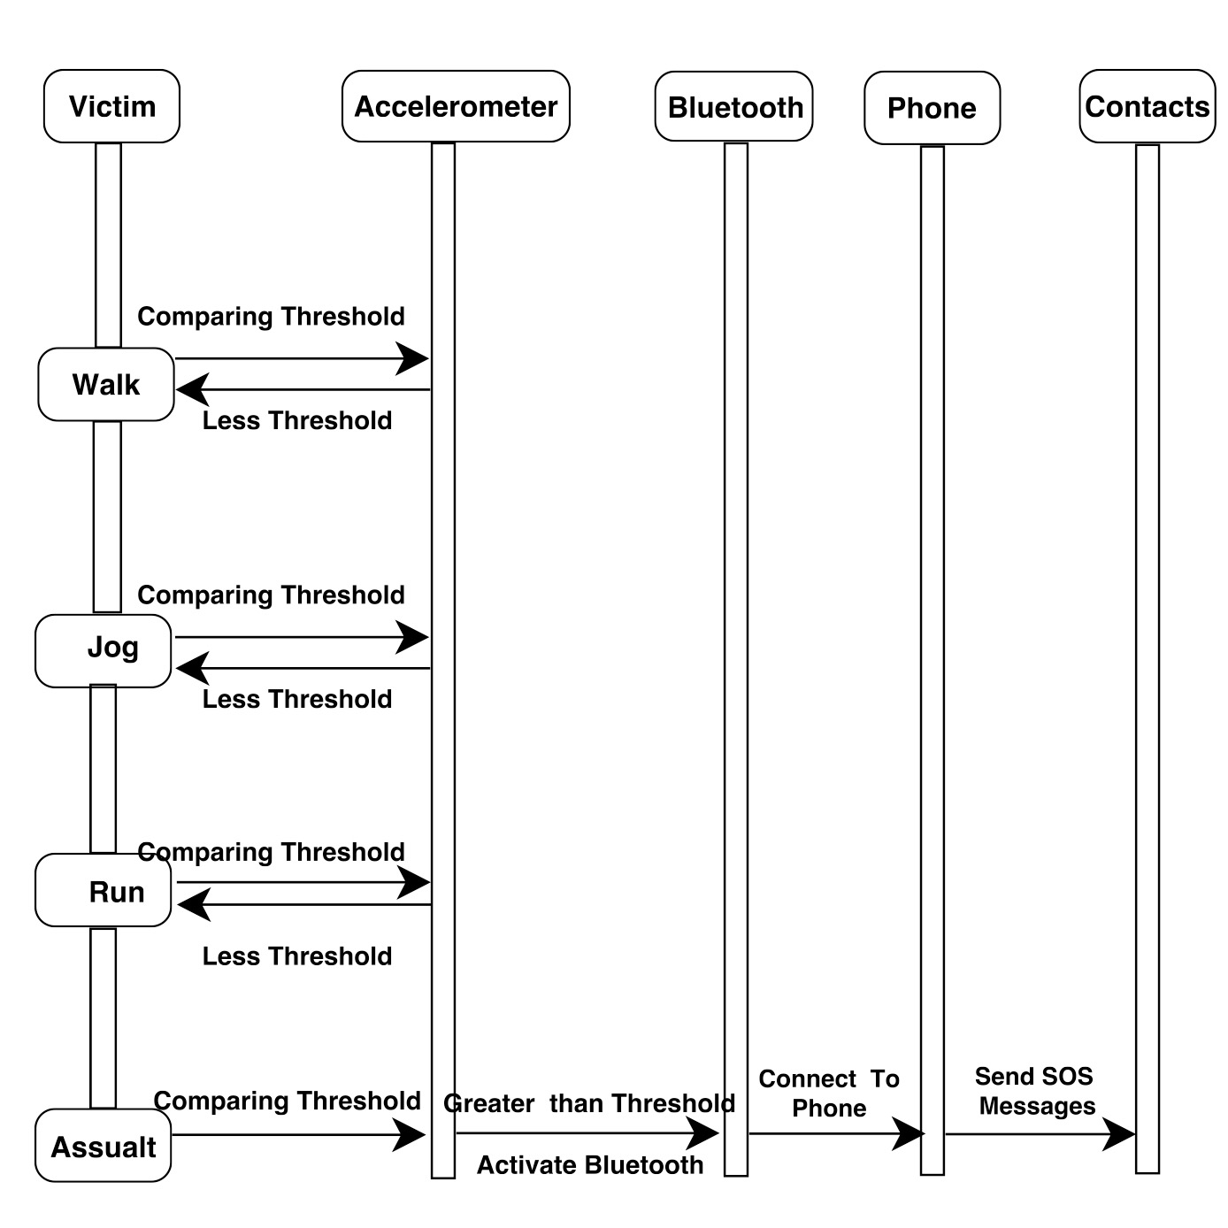
Sequence Diagram
COGNITIVE APPREHENSIVE DEVICE

Slide 13
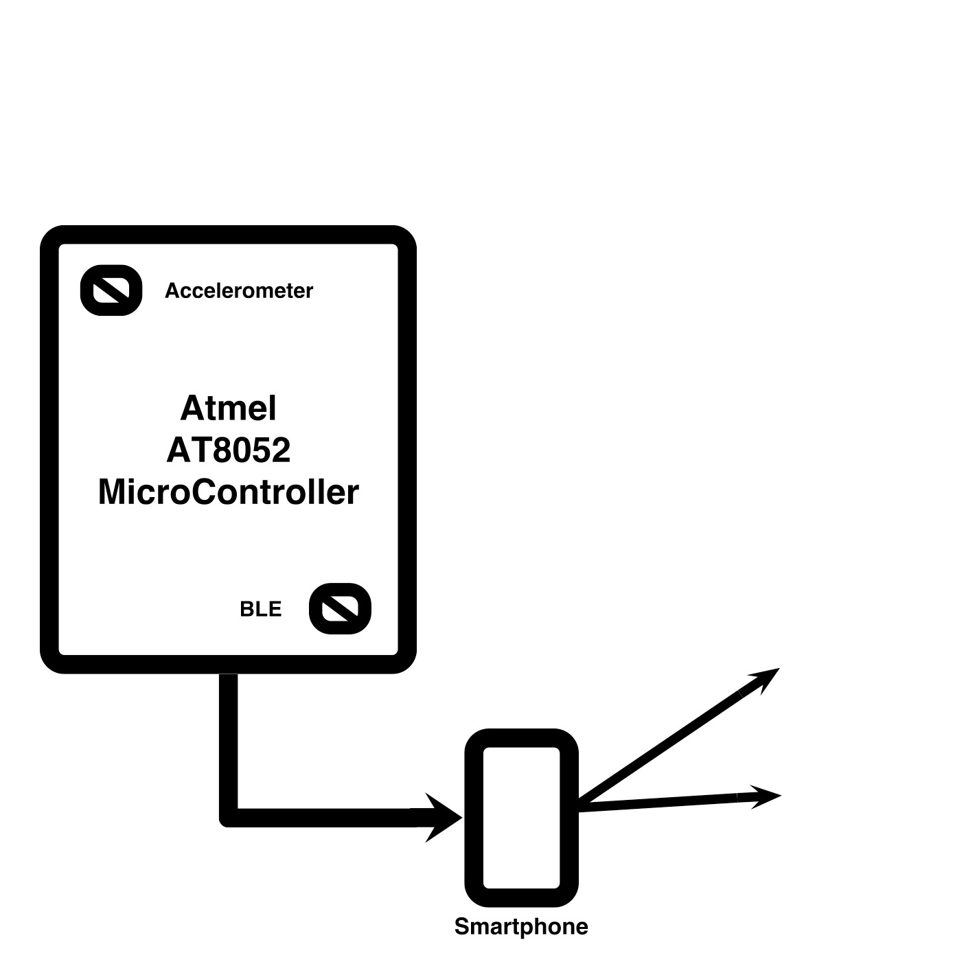
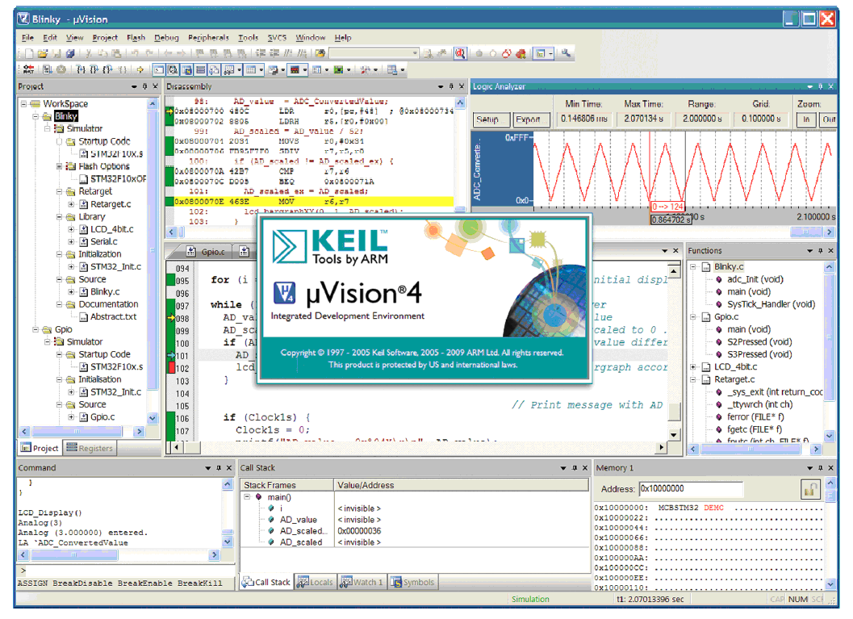
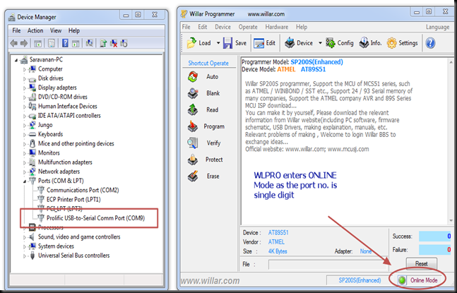
HARDWARE AND SOFTWARE USED
COGNITIVE APPREHENSIVE DEVICE
• HARDWARE
Atmel AT8052 MicroController
3-Axis Accelerometer
BLE(Bluetooth Low Energy)
Handheld Device
Batteries
• SOFTWARE
Keil C166 Development Tools
Willar Programmer(to dump code)
32 bit Operating System
Android Studio

Slide 14
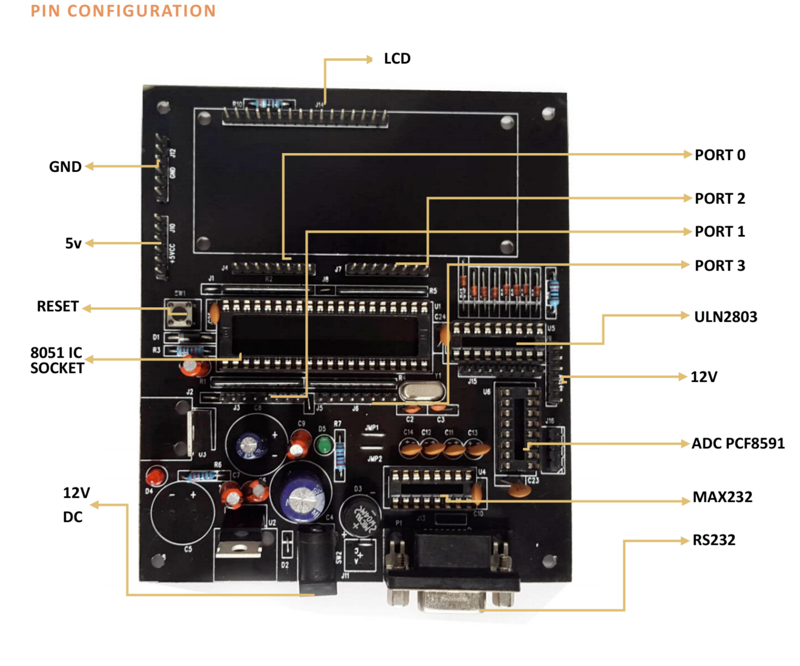
ATMEL AT8051
COGNITIVE APPREHENSIVE DEVICE
• Easy to connect to PC or other embedded hardware through the RS232 port.
• ULN2803 interfacing available to run motors.
• I2c based ADC8591 gives accurate output.
• Extended ports allow any device to be interfaced with this board.
• On board dual power supply covers the requirements of almost all devices.
• On board Quartz Crystal 0f 11.0592 available.

Slide 15
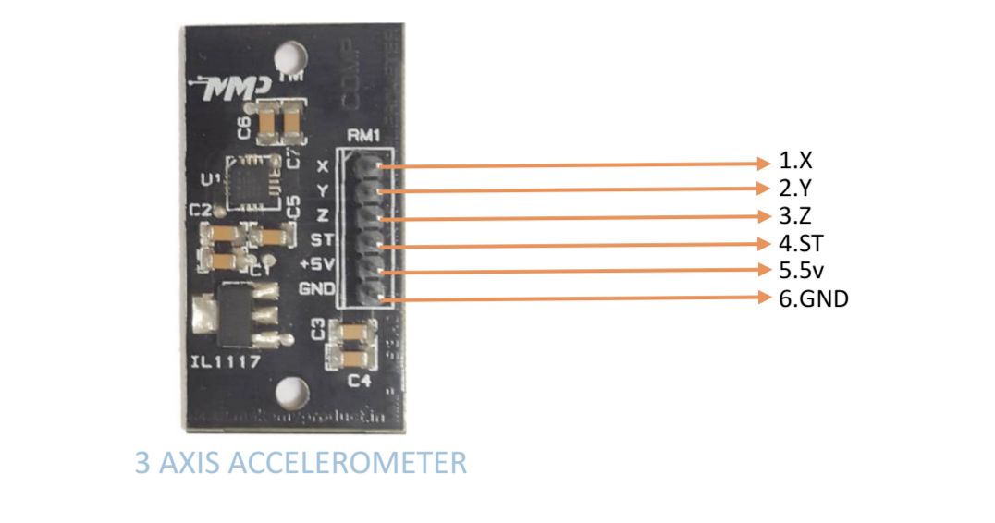
ACCELEROMETER
COGNITIVE APPREHENSIVE DEVICE
1. X: X Axis (analog output). 4. ST
2. Y: Y Axis (analog output) 5. VCC: 3.3V-5.5V power supply
3. Z: Z Axis (analog output). 6.GND: Power Ground.

Slide 16
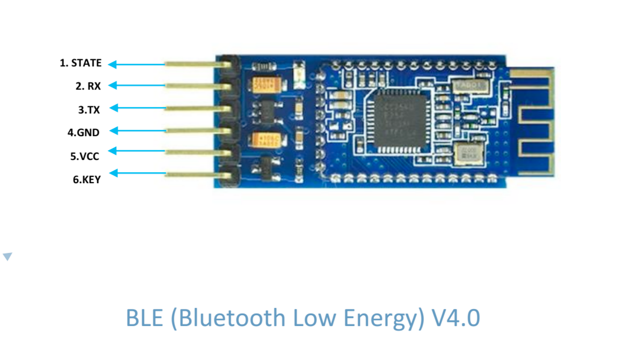
Bluetooth Low Energy
COGNITIVE APPREHENSIVE DEVICE
1. STATE: You can connect an external LED to indicate the Bluetooth state.
2. RXD : Receive data
3. TXD : Send data
4. GND : Power ground
5. VCC : DC power in (3.3V-6VDC)
6. KEY : Turn on/off this module by this pin.

Slide 17


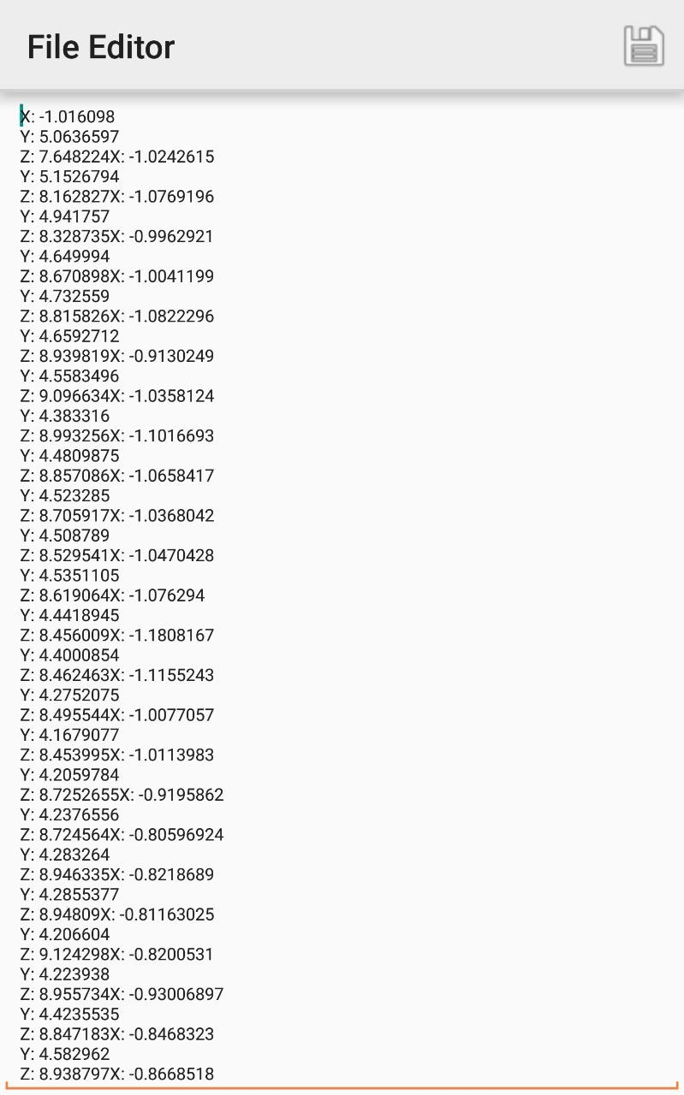
TESTING
COGNITIVE APPREHENSIVE DEVICE
Accelerometer Application.
Sampling accelerometer parameters(X, Y, Z axis).

Slide 18
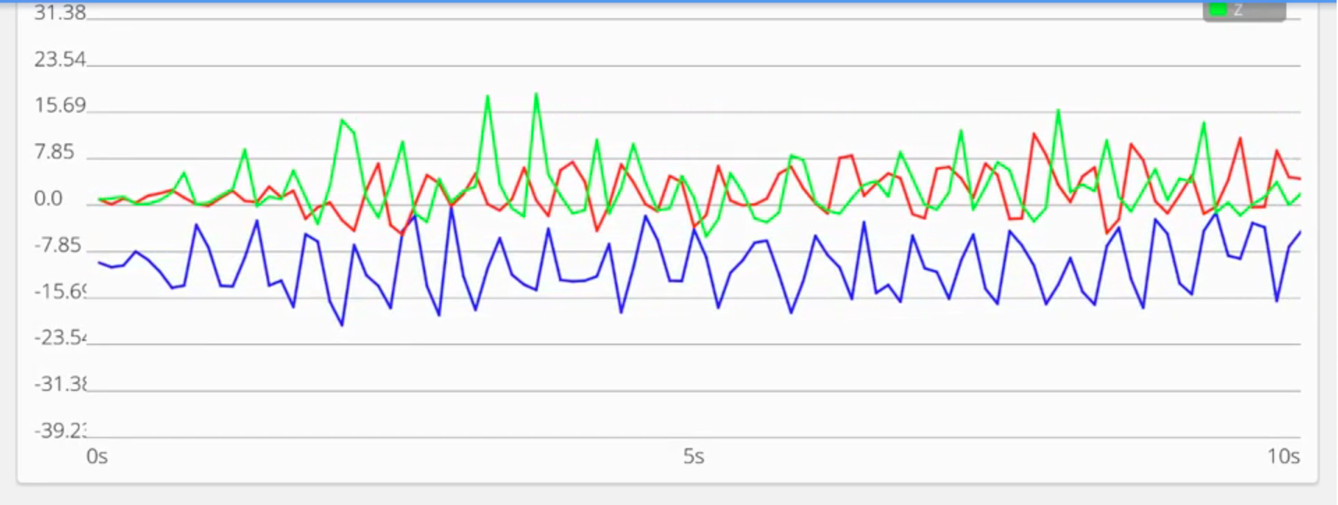
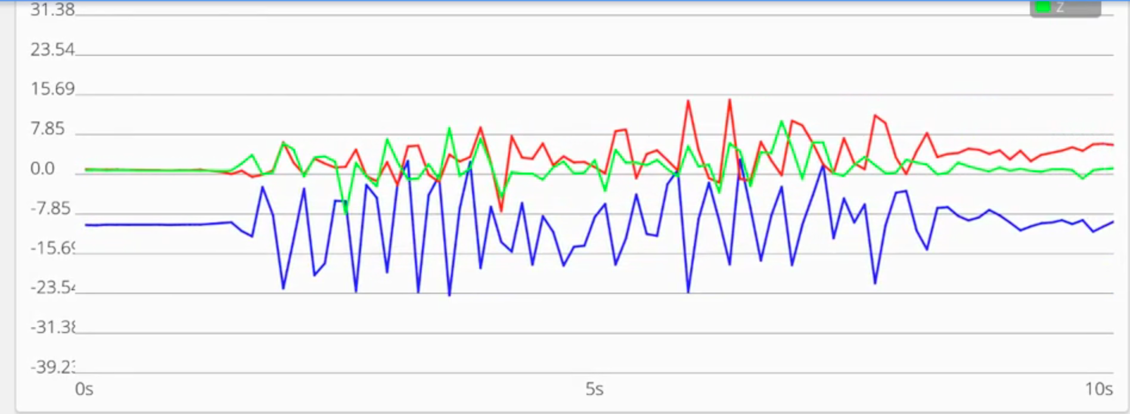
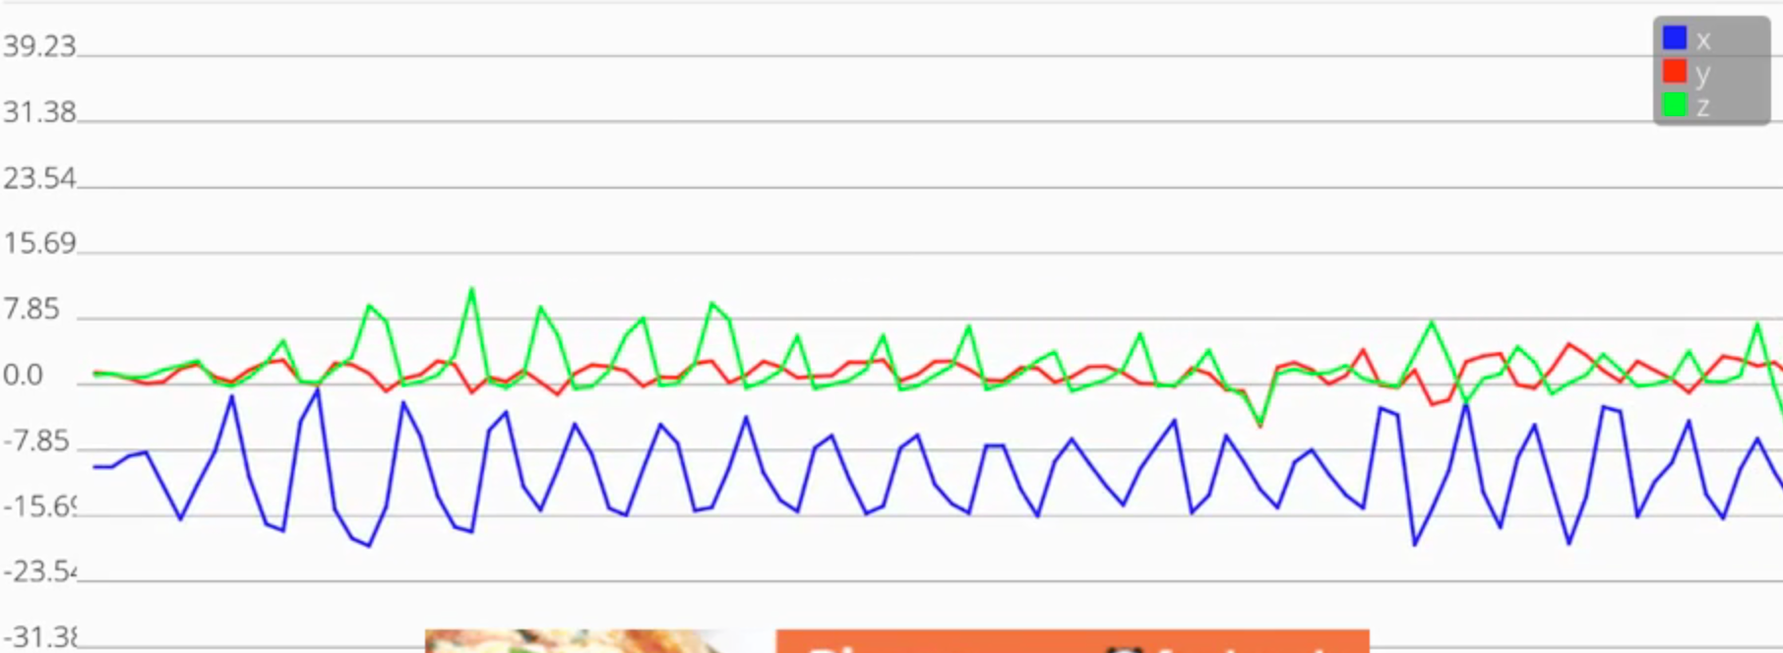
TESTING
COGNITIVE APPREHENSIVE DEVICE
Plotting sample points to plot graphs.
Taking values from graphs(min and max peaks, #of peaks per second, graph slopes values etc. ).

Slide 19
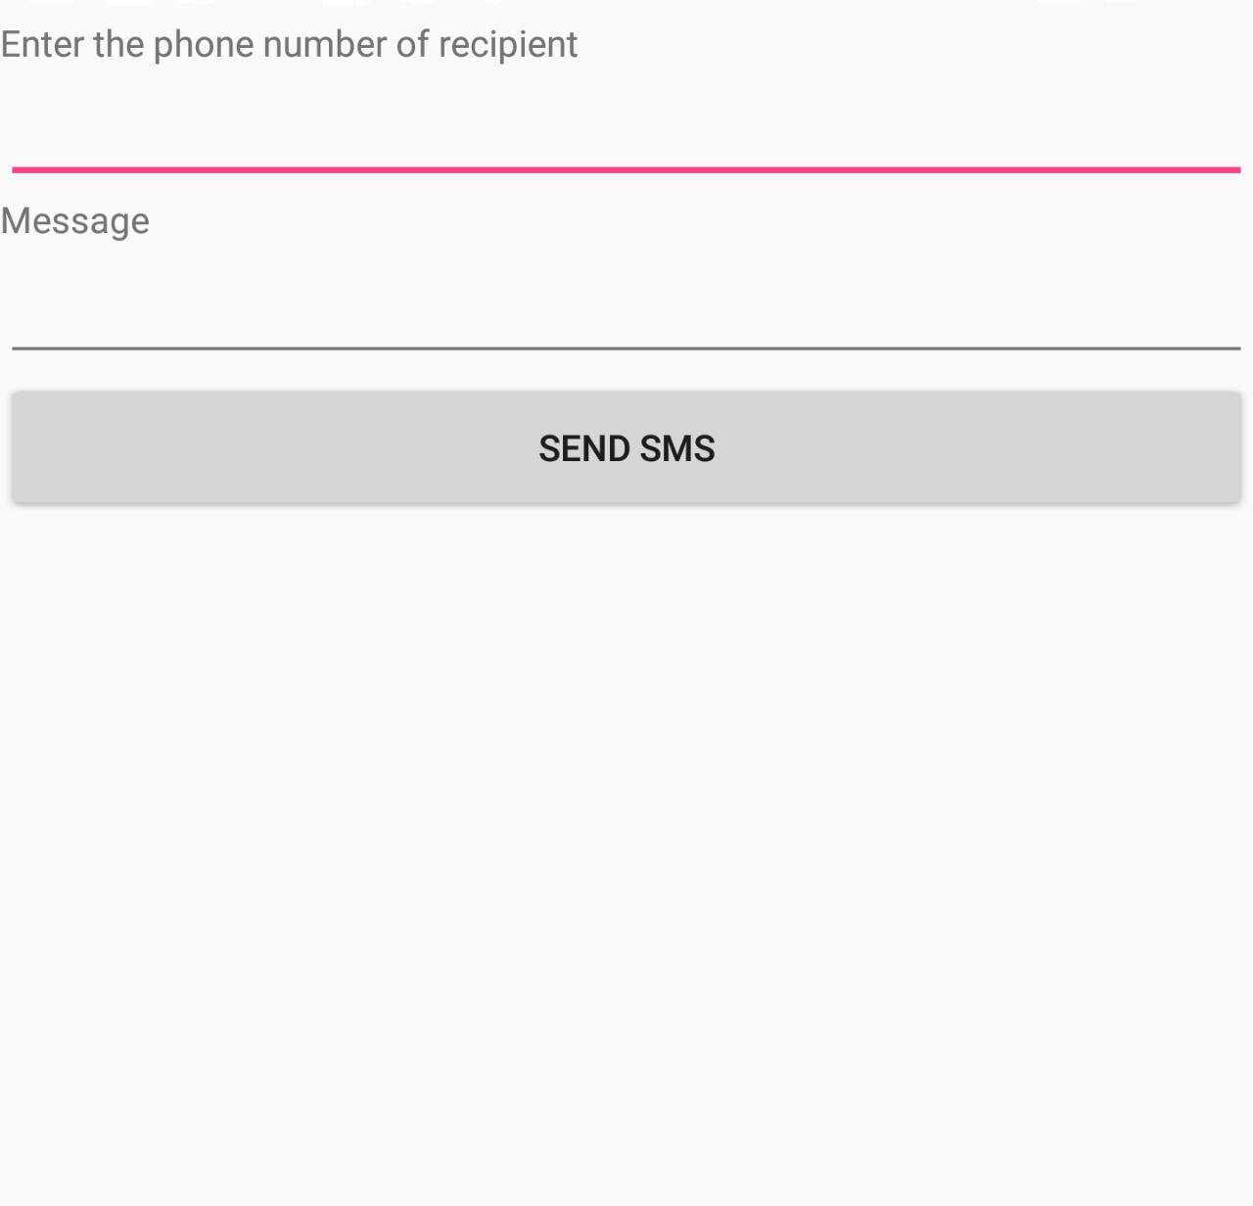
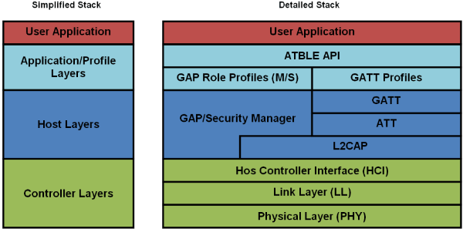
TESTING
COGNITIVE APPREHENSIVE DEVICE
SMS application to identify application needs.
Testing different protocol stacks to work on BLE.

Slide 20
CONCLUSION
COGNITIVE APPREHENSIVE DEVICE
In this work, we have incorporated wearable technology, responsive sensors, actuators and wireless communication which can provide safety measures.
With the use of reliable sensors and lack of a panic button unlike in devices such as Artemis,Cuff,Amulyte and Safelet, our device increases responsiveness of the security devices which makes it less dependable on the user to take emergency steps in a panic situation.
The proposed work is efficient, effective and its real time implementation provides precise and profound security measures in the time of emergency.

Slide 21
FUTURE PROSPECTS
COGNITIVE APPREHENSIVE DEVICE
A 6-dimension accelerometer for better precision in gesture recognition.
Using geo tagged data logging.
Inverse surveillance to ensure the integrity of data.
Precise design model, for a wider range of usage.
Geo - Referencing.
Speech Recognition.

Slide 22
THANK YOU :)

